Slide 1

Cypher
Your Virtual Assistant
ANKUR VERMA
2401730189

Slide 2
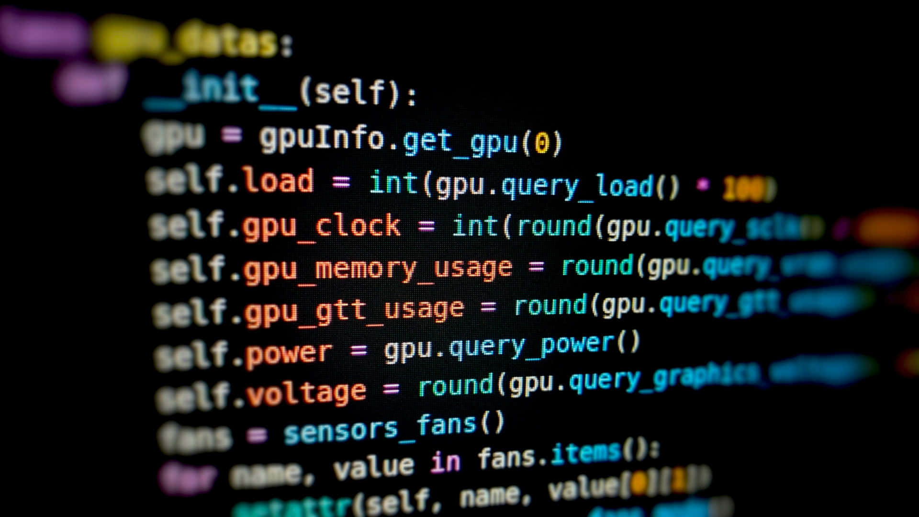
What are Virtual Assistants?
AI-Powered Assistants
Personalized Experience
Virtual Assistants (VAs) are computer programs utilizing Artificial Intelligence (AI) to offer various services. They leverage natural language processing, machine learning, and deep learning to understand and respond to user requests.
VAs offer a personalized experience by learning user preferences and adapting their responses accordingly. They can set reminders, schedule appointments, manage emails, and provide information based on individual needs.

Slide 3

Key Capabilities of Virtual Assistants
1
Task Automation
2
Information Retrieval
VAs can automate tasks like sending emails, setting alarms, and making appointments, freeing up time for more important activities.
VAs can access and retrieve information from the web, providing answers to queries and insights based on user needs.
3
Personalized Recommendations
4
Smart Home Integration
VAs can recommend products, services, and content based on user preferences and past behavior.
VAs can control smart home devices, adjusting lighting, temperature, and other aspects for user comfort and convenience.

Slide 4
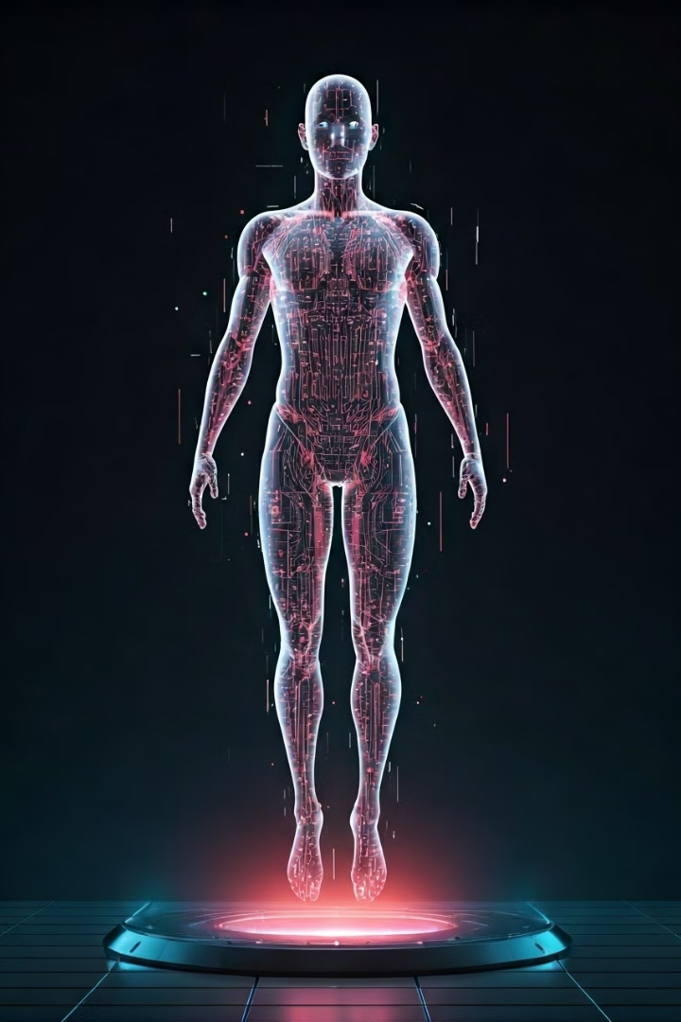
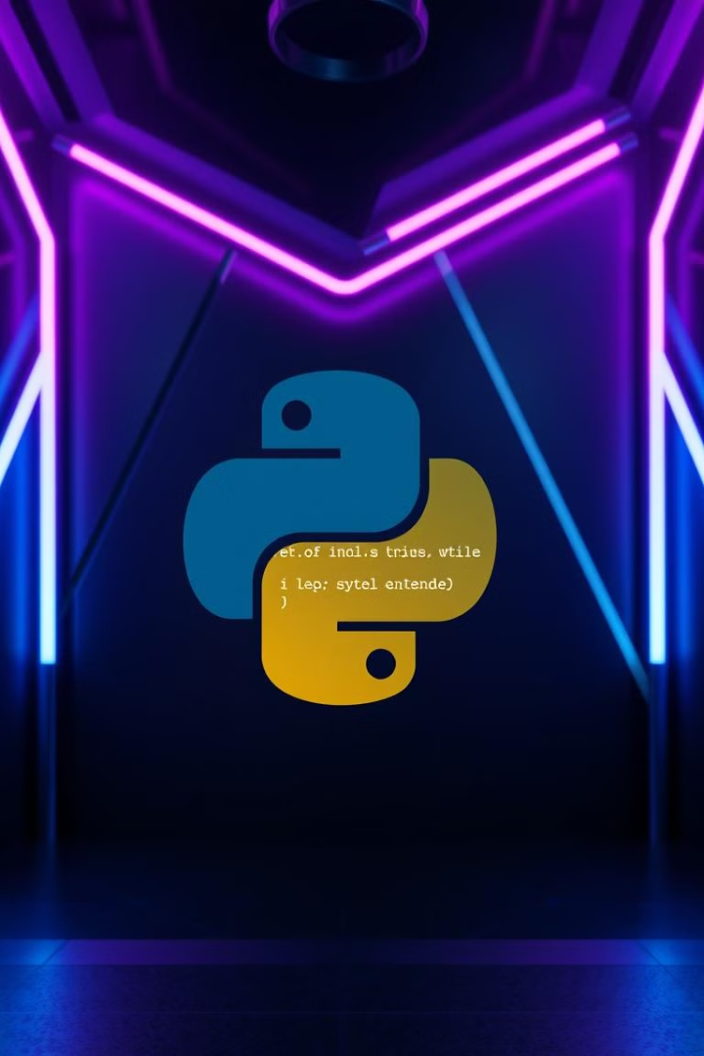
Python Libraries Used
1
Cross-platform GUI automation
2
Simplifying complexity
The three major operating systems (Windows, macOS, and Linux) each have different ways to programmatically control the mouse and keyboard. This can often involve confusing, obscure, and deeply technical details. The job of PyAutoGUI is to hide all of this complexity behind a simple API.
PyAutoGUI is a cross-platform GUI automation Python module for human beings. Used to programmatically control the mouse & keyboard.
3
Windows implementation
On Windows, PyAutoGUI accesses the Windows API (also called the WinAPI or win32 API) through the built-in

Slide 5

01
Speech Recognition Module
Recognition
Audio Processing
Calling the recognize_google() method (or another available recognition method) on the SpeechRecognition library to convert the audio data into text.
Audio Capture
Converting the audio signal into data that the SpeechRecognition library can work with.
Installation and Import
Capturing audio from the microphone using PyAudio.
pip install SpeechRecognition import speech_recognition

Slide 6





02
Pyttsx3 Library
Installation and Import
pip install pyttsx3 import pyttsx3
Text-to-Speech Conversion
pyttsx3 is a text-to-speech conversion library in Python. An application invokes the pyttsx3.init() factory function to get a reference to a pyttsx3. Engine instance. it is a very easy to use tool which converts the entered text into speech.
Voice Support
The pyttsx3 module supports two voices first is female and the second is male which is provided by "sapi5" for windows. It supports three TTS engines :
Windows Support
sapi5 – SAPI5 on Windows

Slide 7

03
OS Module
Installation and Import
Functionality
Key Features
pip install os import os
The OS module in Python provides functions for interacting with the operating system. OS comes under Python's standard utility modules. This module provides a portable way of using operating system-dependent functionality.
Handling the Current Working Directory
Creating a Directory
Listing out Files and Directories with Python
Deleting Directory or Files using Python

Slide 8

04
Pyautogui Library
Installation and Import
Description
Functionality
Windows Implementation
pip install pyautogui import pyautogui
PyAutoGUI is a cross-platform GUI automation Python module for human beings. Used to programmatically control the mouse & keyboard.
The three major operating systems (Windows, macOS, and Linux) each have different ways to programmatically control the mouse and keyboard. This can often involve confusing, obscure, and deeply technical details. The job of PyAutoGUI is to hide all of this complexity behind a simple API.
On Windows, PyAutoGUI accesses the Windows API (also called the WinAPI or win32 API) through the built-in

Slide 9
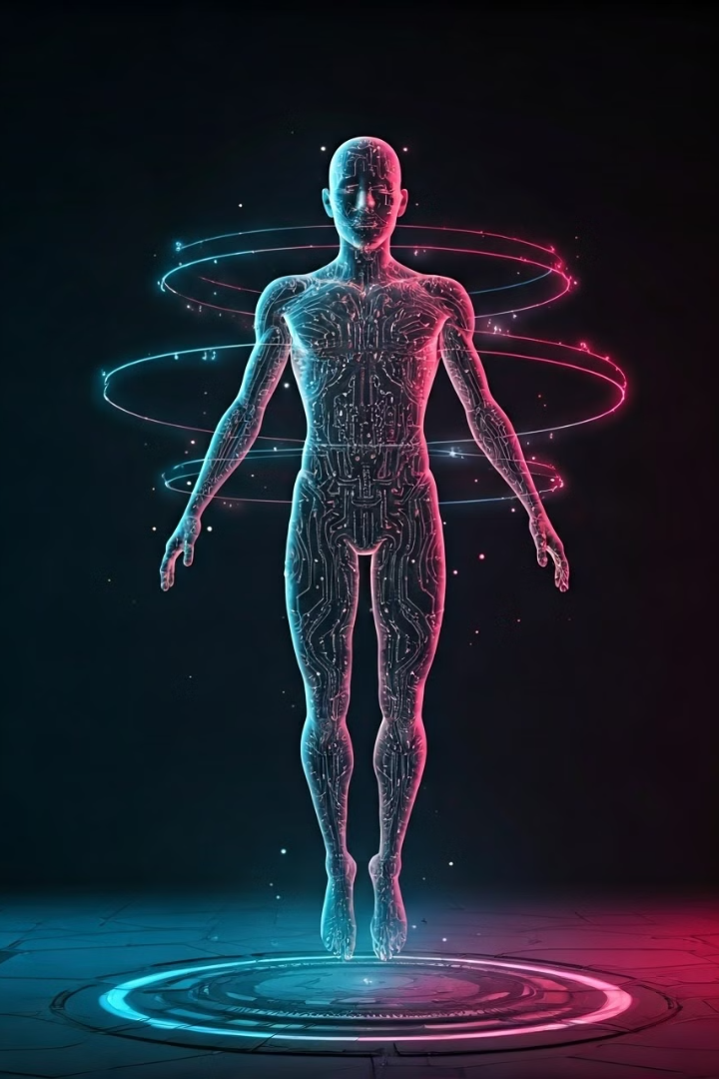


Cypher's Capabilities
Information retrieval
Entertainment
Get quick answers to questions, search for information, or translate languages.
Play music, podcasts, or audiobooks; control smart home devices.

Slide 10

Additional Capabilities
1
Search
Gather information, analyze data, and generate insights.
2
Desktop automation
Control browser, open Youtube, and other application.

Slide 11
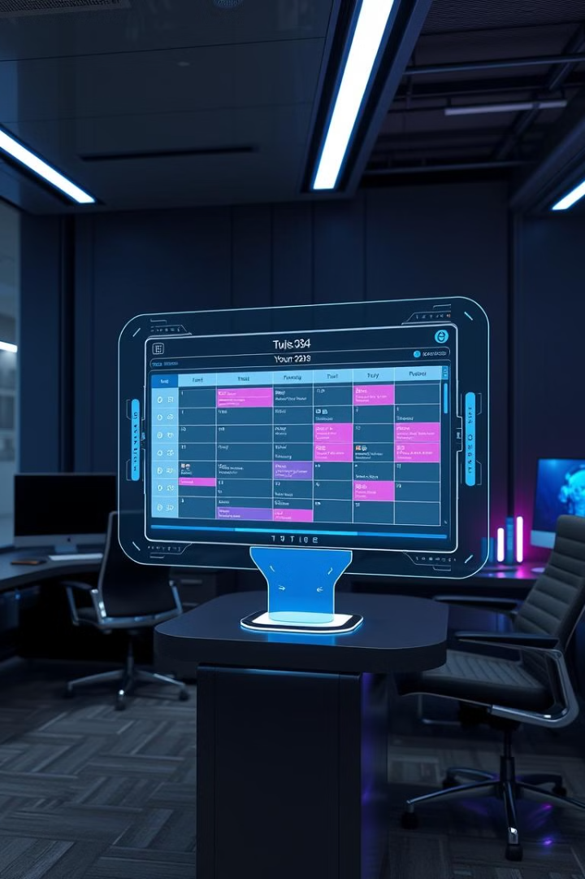
How Virtual Assistants Can Improve Productivity
Task Delegation
VAs can handle routine tasks, allowing users to focus on more strategic and creative activities.
Time Management
VAs can manage schedules and set reminders, ensuring that tasks are completed on time and deadlines are met.
Information Access
VAs provide quick access to information, reducing time spent on research and information gathering.
Enhanced Collaboration
VAs can facilitate seamless communication and collaboration, improving team productivity and workflow efficiency.

Slide 12

The Future of Virtual Assistants: Trends and Predictions
1
Advanced NLP
VAs will become more sophisticated in understanding natural language, leading to more accurate and natural interactions.
2
Increased Personalization
VAs will personalize user experiences based on individual preferences, habits, and needs.
3
Enhanced Multimodality
VAs will integrate seamlessly with various devices, platforms, and modalities, offering a more fluid and interactive experience.
4
Expanded Capabilities
VAs will evolve to handle more complex tasks, becoming more integral to daily life and business operations.

Slide 13
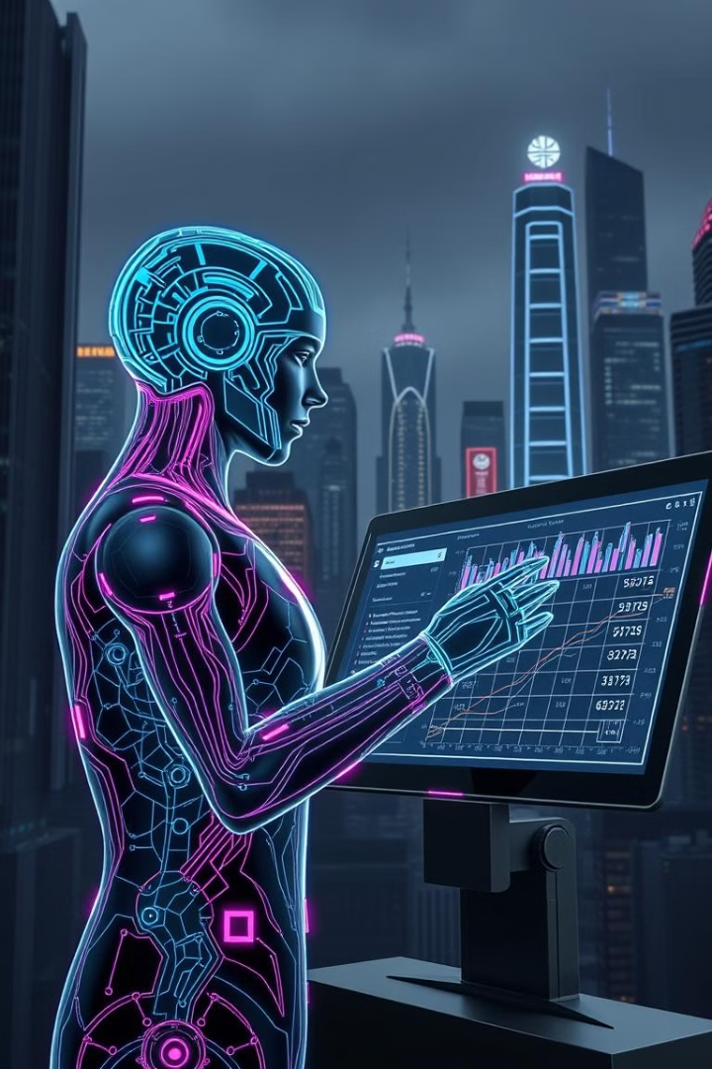
Future Improvements
100%
Accuracy
Continuously improve language understanding and response accuracy.
50%
Personalization
Develop more sophisticated algorithms for personalized experiences.
100M
Integration
Enhance integration with diverse platforms and devices.
100K
Capabilities
Expand capabilities to address emerging needs and trends.

Slide 14
FUTURE IMPROVEMENTS
Compatibility
1
Enhance cross-platform functionality to ensure seamless integration with various operating systems, devices, and third-party applications. This includes better support for mobile platforms and cloud services.
2
Improve Working
Optimize performance and response times through enhanced algorithms and more efficient processing. Focus on reducing latency and improving the accuracy of task execution across all functions.
More User Friendly
3
Develop a more intuitive interface with clearer navigation, simplified commands, and better error handling. Implement user feedback to create a more accessible and enjoyable experience for all skill levels.
4
AI Integration
Incorporate advanced machine learning capabilities to enable more sophisticated natural language processing, predictive analytics, and personalized user experiences. This will allow the assistant to better understand context and user preferences over time.

Slide 15
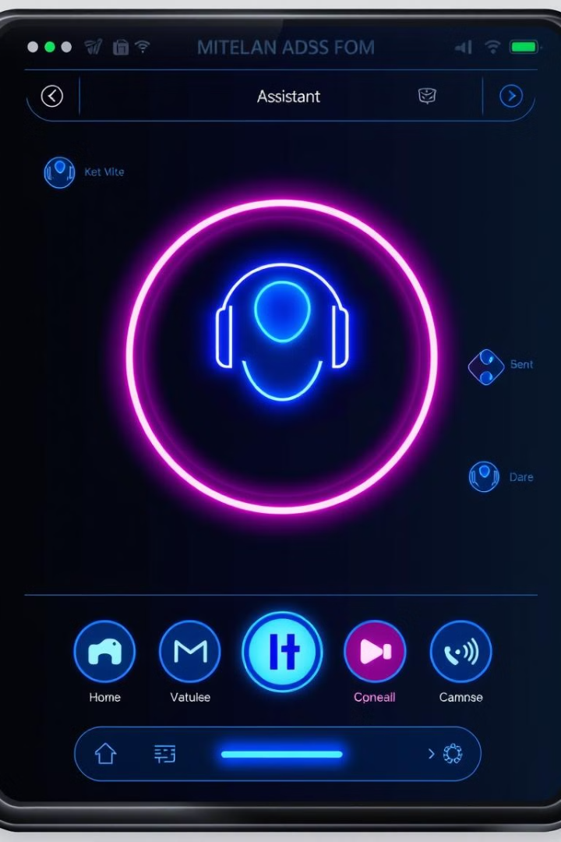




Designing an Effective Virtual Assistant Interface
Intuitive and easy to navigate
Customizable settings for personalization
Natural language processing for seamless interaction
Integrated feedback mechanisms for continuous improvement

Slide 16




The AI Revolution: Harnessing the Power of Virtual Assistants
Enhanced Efficiency
1
VAs automate tasks, improving productivity and freeing up time for more valuable pursuits.
Personalized Solutions
2
VAs tailor services to individual needs and preferences, enhancing user experiences.
Improved Accessibility
3
VAs provide access to information and services for all, fostering inclusivity and empowerment.
Transformative Innovation
4
VAs are driving innovation across industries, shaping the future of work and lifestyle.

